Slide 1
Review of UI choices for mobile development
Presented by Jason Meckley
t: @jasonmeckley e: jasonmeckley@gmail.com

Slide 2
A little bit about me
Jason Meckley
MCSD: Web Applications
.Net Developer for 12 years
Associate Architect with CEI, Inc.
Avid home brewer
Father to 2 beautiful daughters

Slide 3
Environments
Native
HTML5
Hybrid
Notes:
What we will cover in this presentation

Slide 4
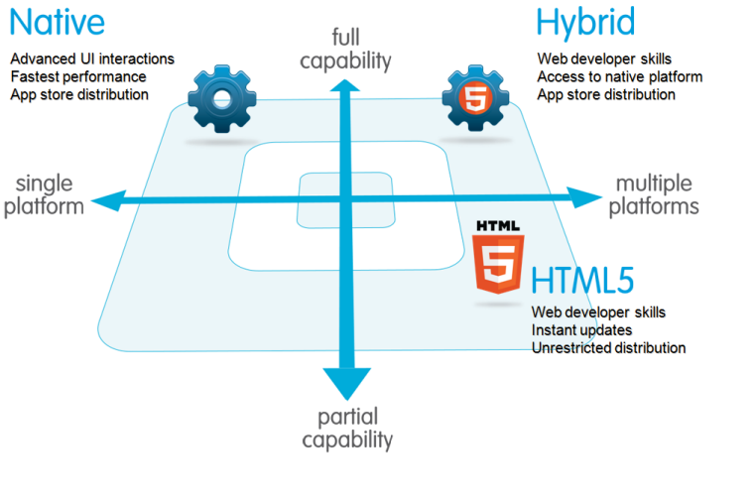
Overview

Slide 5
Native Apps
Pros:
Fully featured
Multi touch : double tap, pinch-spread, etc.
Fast graphics/Fluid animation
Built in components: camera, geo-location, etc.
Ease of use: users are accustom to the presentation
Offline functionality
Documentation

Slide 6
Native Apps
Cons
Platform specific languages
iOS: objective-c
Android: java
Windows: .Net
Language specific IDE
iOS: Xcode
Android: Eclipse
Windows: Visual Studio
App Store deployment
Notes:
Developers need to be skills in each language
Managing release cycles across various platforms

Slide 7
HTML5 Apps
Pros
Device Agnostic
Runs in any modern browser
Searchable on the web (SEO)
Write-once-run-anywhere
Easy deployment
Easy transition for web developers
Notes:
Although modern browsers still have their quirks. They interpret CSS3 and input controls differently.
SEO: search engine optimization
Write-once-run-anywhere: html, css, js
Don’t have to deal with the App Store

Slide 8
HTML5 Apps
Cons
Browser can interpret CSS differently
No support for native functionality
Styling may not conform to native standards
100% Online
Slower load times
Notes:
“There are no such things as legacy browsers. There are browsers and there is IE.”
Camera, multi touch, geo-location (although, browsers have this too.)

Slide 9
Hybrid App
What is it?
HTML5 app hosted as a native app
Hosted within an embedded web browser
Tools
PhoneGap/ Cordovia
Appcellerator’s Titanium

Slide 10
Hybrid App
Pros
Combines the best of HTML5 & Native apps
Write-once-run-everywhere
Access to local features
Partial off-line functionality

Slide 11
Hybrid App
Cons
Apps Store
Slower response times
Notes:
Slower response times compared to a fully native app

Slide 12
Hybrid App
Deployment Options
Local:
Package html, JS & CSS within the app binary.
REST APIs to transfer data.
Very similar to Native app
Server
Implement as a full website
Options for local caching
Embedded browser becomes a thin wrapper around the website.

Slide 13
Comparison of features
 | Native | HTML5 | Hybrid
App Features
Graphics | Native APIs | HTML, Canvas, SVG | HTML, Canvas, SVG
Performance | Fast | Slow | Slow
Native look and feel | Native | Emulated | Emulated
Distribution | Appstore | Web | Appstore
Device Access
Camera | Yes | No | Yes
Notifications | Yes | No | Yes
Contacts, calendar | Yes | No | Yes
Offline storage | Secure file storage | Shared SQL | Secure file system, shared SQL
Geolocation | Yes | Yes | Yes
Gestures
Swipe | Yes | Yes | Yes
Pinch, spread | Yes | No | Yes
Connectivity | Online and offline | Mostly online | Online and offline
Development skills | ObjectiveC, Java | HTML5, CSS, Javascript | HTML5, CSS, Javascript

Slide 14
How do I know which one to choose?
Device features
Offline functionality
Discoverability
Spped
Installation
Platform Independence
Development costs/maintenance
User Interface
Notes:
Factors to consider

Slide 15
How do I know which one to choose?
“The choice between native and hybrid approaches is dependent on business needs, app requirements, developer skill, development timeline, and other factors.”
Todd Anglin, a EVP at cross-platform development toolmaker Telerik

Slide 16
Overview

Slide 17
Web & Hybrid UI libraries
Visual controls
jQuery Mobile
Twitter Bootstrap
Ionic
Chocolate Chip UI*
Pure**
Skeleton**
Client Frameworks
AngularJS
KnockoutJS
EmberJS
Full Stack
Sencha Touch
Kendo UI
Wijmo
Notes:
JQuery mobile.
Older(est) library
UI controls
Considered “heavy”. Lots of markup
Twitter Bootstrap
Depends on jQuery
v3.x favors declaration over imperative programming
Some limitations with IE8 & 9
Ionic
Truly mobile 1st. focus on native & hybrid environments
Angular directive
Chocolate chip UI
has some client framework features, but no routing
Pure & Skeleton
CSS media queries only.
Better suited for designers with strong CSS skills.
AngularJS
Developed by Google
MVVM
Declarative view and wiring
Imperative logic
Extends HTML vocabulary
V1.2 supports IE 8+
V1.3 supports IE 9+
Favor ng-attribute over ng-tag (or define tags in IE)
Compatible with jQuery, but has it’s own jQuery-lite
Many small components
Batarang – ng inspector
KnockoutJS
Developed by Microsoft
No dependencies
MVVM framework
Supports IE 6+
Heavy use of data-bind attribute
Not built-in routing
Knockout inspector
EmberJS
Handlebar data binding/declarations
Routing built-in
emberJS inspector
Pairs well with UI libraries
Sencha Touch
100% imperative programming
Many UI rich components
One stop shop
Free/$$$
Kendo UI
Telerik
jQuery plug-ins
More traditional/legacy development practices (could just be how I’m using it)
Core – free / professional - $$$
40/70 widgets
Wijmo
ComponentOne
Built on jQuery, jMobile & Knockout
SpreadJS
Has Angular directives.

Slide 18
Demos!
Twitter Bootstrap/KnockoutJS
Ionic/Angular

Slide 19
Security Concerns
Speed to Market kills security
Secure communications
Encrypt sensitive data
Lock down APIs
Avoid elevated privileges

Slide 20

Questions

Slide 21
Thank You
Jason Meckley
t: @jasonmeckley
e: jasonmeckley@gmail.com
Notes:
Again, thank you for your time. I know you have many excellent choices for this time slot and I appreciate that you chose Review of UI choices for mobile development

